Slide 1


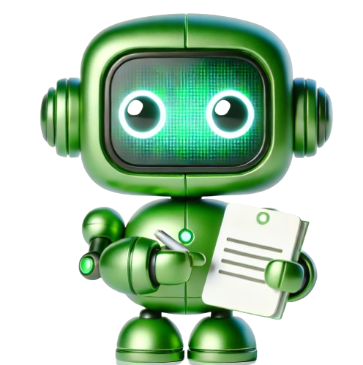





VALENTINA ALTO
JAN 25, 2025
AI AGENTS FOUNDATIONS

Slide 2
AGENDA
Topic | Time
Recap and Setup | 9:00 - 9:15
Designing the agent from a challenge statement | 9:15 – 9:30
Demo: e-commerce Agent + code walkthrough | 9:30-10:15
Hands-on! Design thinking ~ 30’ Code ~ 1h Q&A ~ 15’ | 10:15 - 12
Notes:
Module 3: Practical Agent Development (Build Your Own Agent Lab)
Recap & Setup (9:00 – 9:15): Quick recap quiz on Day 1 key points (e.g. “What does ReAct stand for in agent context?”, “Name one limitation of LLMs we must handle.”). Ensures everyone is ready to apply those concepts. Outline of the morning project: participants will code a mini-agent end-to-end.
Designing the Agent (9:15 – 10:00): Collaborative design of an example agent. Instructor introduces a scenario (e.g. “E-commerce Agent” that classifies support tickets and drafts responses, or a “Research Assistant Agent” that fetches info and summarizes). The class discusses requirements: what tools or data would it need? How to break the task into steps?
The agent design is sketched out: decide on the LLM to use, define any external tools (e.g. search, database), and outline the agent’s workflow. Emphasize good prompt design and setting clear agent goals.
Key Consideration: Attendees learn how to scope an agent project and what simplifications are needed for a 2-day build.
Live Coding – Step by Step (10:00 – 11:30): Instructor leads a code-along session to implement the agent. Using an interactive notebook or shared screen, she writes the agent code in parts, explaining each step:
Initializing the LLM (and API keys)
Defining Tools: e.g. if the agent uses a web search or a custom knowledge base, set up those tool functions.
The Agent Loop: Write the logic for the agent to take user input, decide actions (using a simplified reasoning approach or leveraging a framework’s agent class), and produce an output.
Memory Management: If needed, implement a simple memory to remember past conversation or results.
Testing the Agent: Run the agent on a sample task and debug any issues.
Participant Coding: At each step, participants are encouraged to write the code along with the instructor. Checkpoints are provided: after each major part, everyone runs their partial implementation to verify it works (e.g. after tool setup, test the tool independently; after agent loop, test a single iteration). This iterative build ensures no one falls behind.
Interactive Troubleshooting: Common errors (API not responding, JSON parse errors, etc.) are intentionally simulated or addressed, teaching debugging skills for agent development.
Introduction to agentic protocols (11:30 – 12:00): In this section, we will introduce the concept of communication protocols for tools and agents calling, including MCP, A2A and ACP. We will also demonstrate how to exposes tools through this protocol and invoke them from your LangChain agent.
Outcome: By lunch, each attendee has a working agent prototype on their machine. They have hands-on experience with coding an agent and are prepared to build a more complex one for the project. The session underlines that with modern frameworks, developing an agent can be done rapidly with the right guidance.

Slide 3

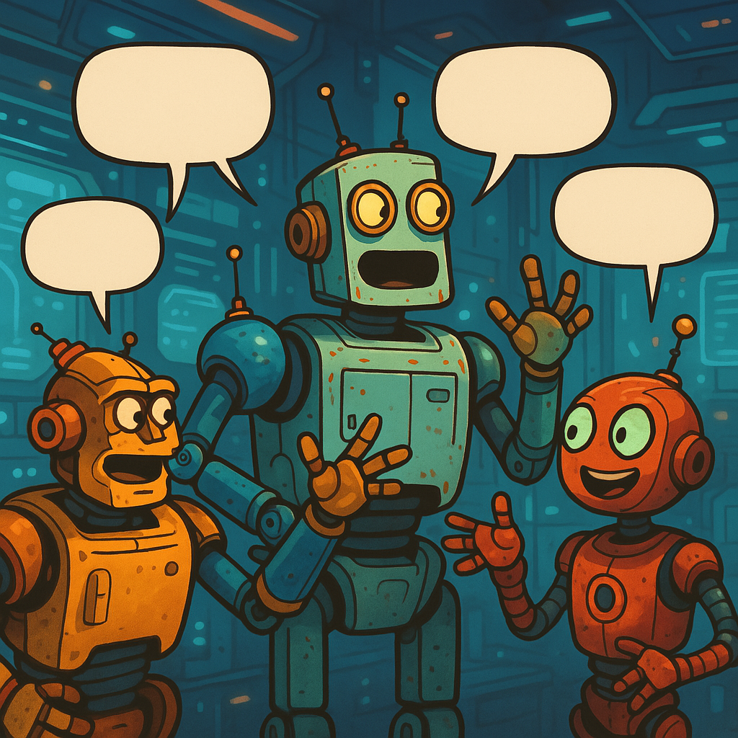


RECAP OF DAY 1
Anatomy of an AI Agent
Communication patterns
Key design principles
Business Model

Slide 4
DESIGN THINKING
To facilitate creative problem solving let's use the Stanford D-School "Design thinking" methodology. Learn more
What insights did you learn that you could leverage in your design?
Define the problem statement.
Take the solution you landed on from the Ideate section and start building.
Share your prototype for feedback
Get your prototype in front of the people that need this solution.
Capture their feedback and if needed, go back and edit your prototype to make it even better.
Empathize
Ideate
Define
Prototype
Test
What processes do they use today?
Are there any existing points of friction?
What might make their experience better?​
If you had a magic wand to help them, what would happen?
Go for quantity over quality, this is the time to generate ideas, not refine (that'll happen later).
Share your ideas and capture feedback.
Iterate based on feedback.
Reflect and iterate.

Slide 5
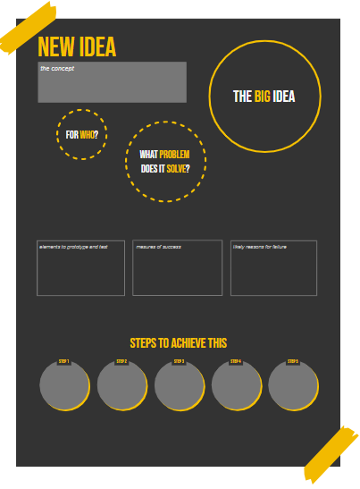
PROBLEM STATEMENT AND IDEATION
What’s the north star you are pursuing?
Who’s gonna help?
What’s the business Challenge?
What do we prototype today?
What’s the business Challenge?
Why might it fail?
How do we achieve it?

Slide 6
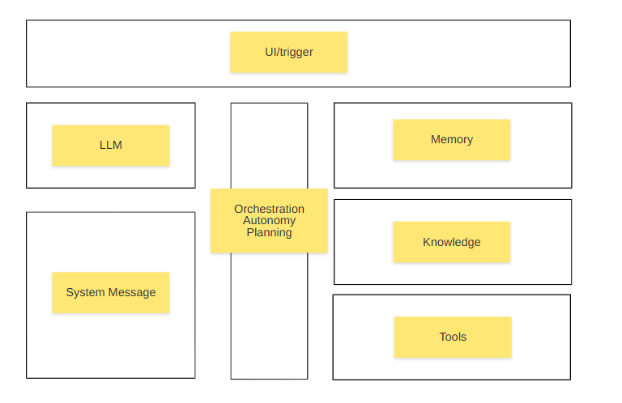
AGENT IDENTIKIT

Slide 7
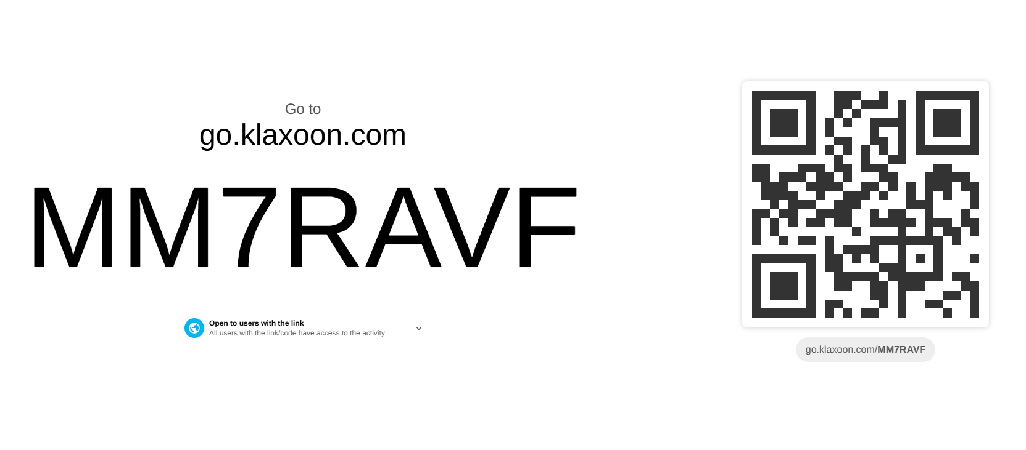
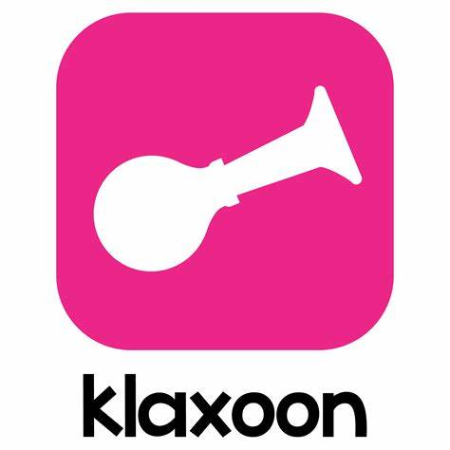
BEFORE CODING…

Slide 8

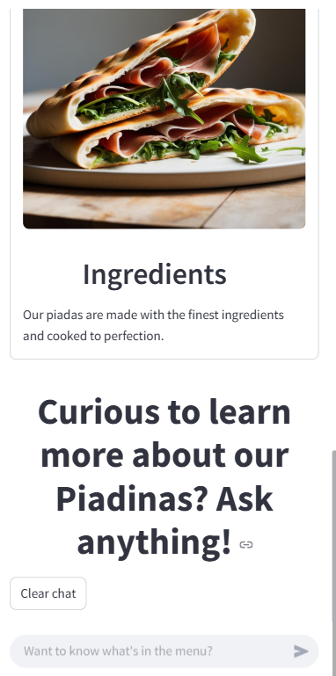
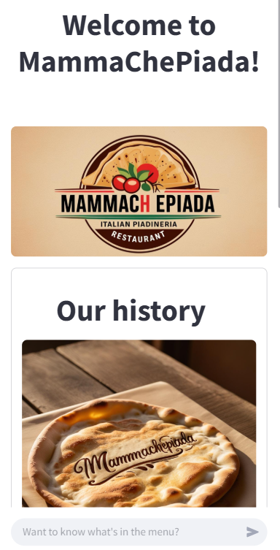

Slide 9
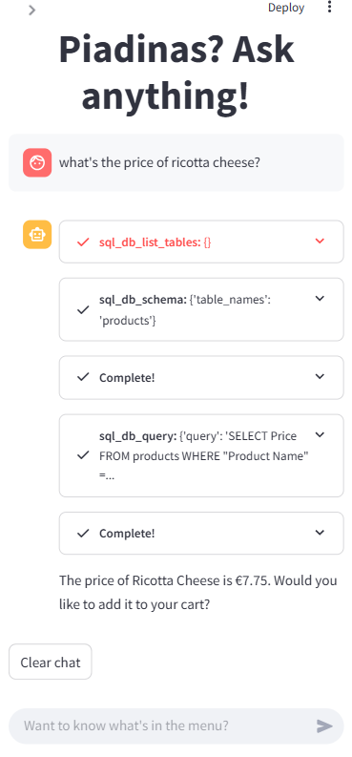
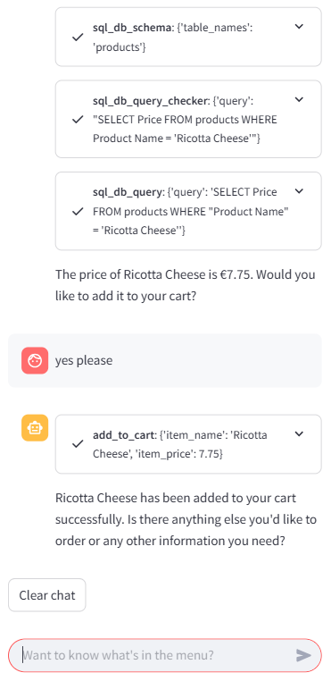

Slide 10
ANATOMY OF AN AI AGENTIC APP
UI (optional)
LLM
Memory
Orchestration
Knowledge base
System message
Tools
Notes:
Try to reverse

Slide 11


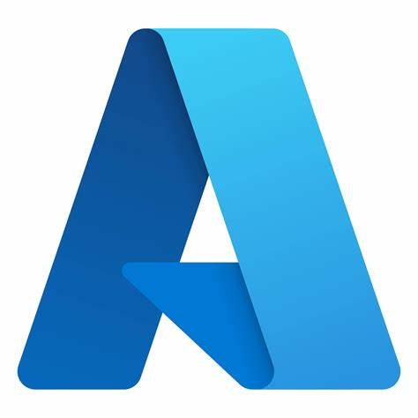

ANATOMY OF AN AI AGENTIC APP
📱Mobile App
Azure OpenAI GPT-4o
User session
🗂️
Orchestration
Food safety certificates
You are an AI assistant for a Piadineria Restaurant.
You help customers explore the menu and choose the best piadine or Italian specialties through friendly…..
📝
📖
SQL DB
Add to cart
🗄️
🛒
Notes:
Try to reverse

Slide 12



AI AGENTS OPEN PROTOCOLS
Model Context Protocol
Agent to Agent
NLWeb

Slide 13
AI AGENTS OPEN PROTOCOLS
Model Context Protocol
Agent to Agent
NLWeb

Slide 14

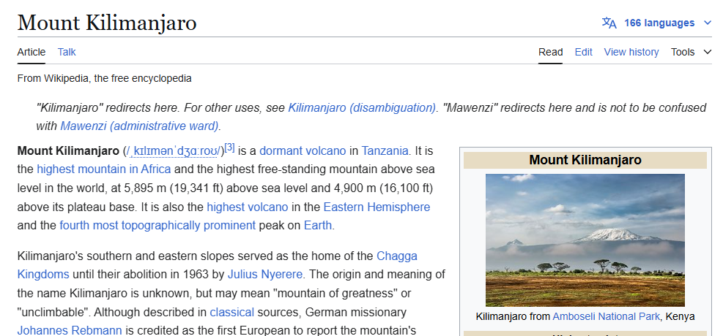
WHAT IS A PROTOCOL?
http://
HTTP request
GET /wiki/Mount_Kilimanjaro
Browser
http://
HTTP Response
Client
Server

Slide 15



WHAT IS AN API?
HTTP request
GET /api/mountains/kilimanjaro
HTTP Response
{
"name": "Mount Kilimanjaro",
"elevation": 5895,
"location": "Tanzania"
}
REST Client
Server

Slide 16
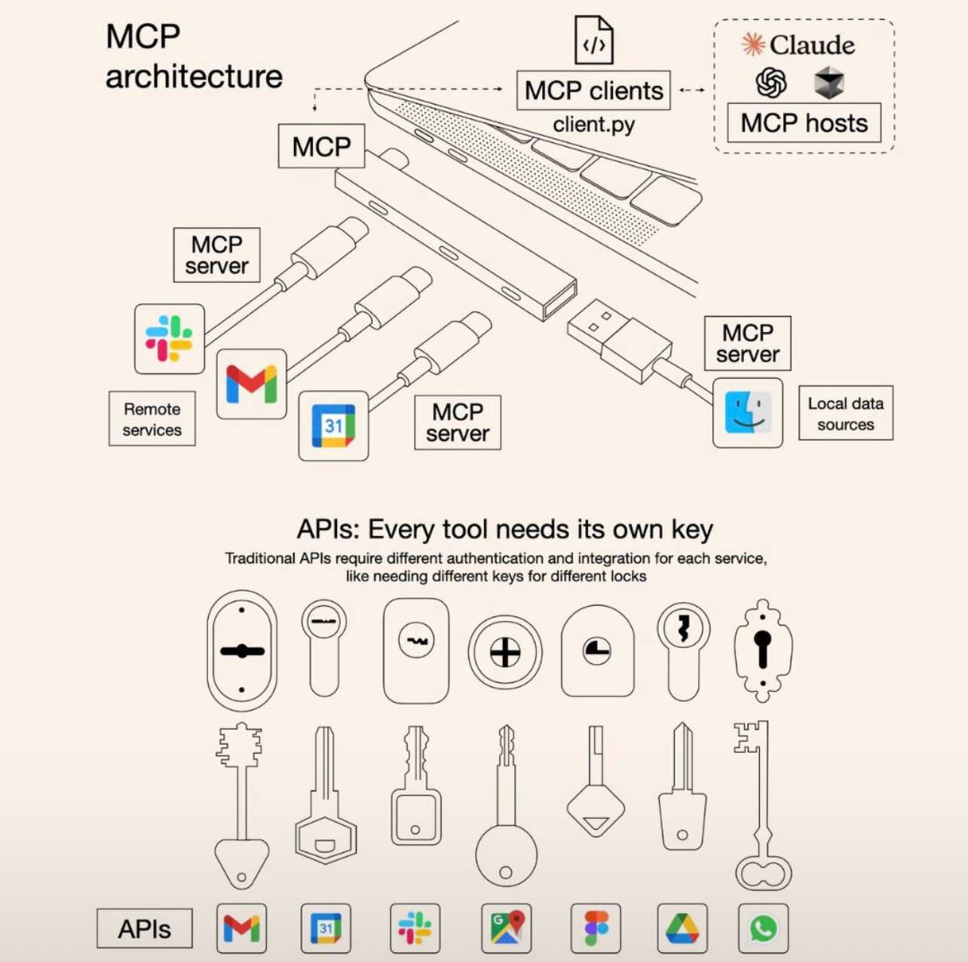
MODEL CONTEXT PROTOCOL
“MCP is an open protocol that standardizes how applications provide context to LLMs. Think of MCP like a USB-C port for AI applications. Just as USB-C provides a standardized way to connect your devices to various peripherals and accessories, MCP provides a standardized way to connect AI models to different data sources and tools.”
Source: https://blog.csdn.net/ChailangCompany/article/details/146354913
Source: https://modelcontextprotocol.io/introduction

Slide 17
HIGH-LEVEL ARCHITECTURE OF MCP
MCP Server
{ name: string; description?: string; inputSchema: type: "object", properties: { ... } } }
MCP Host
Tool
MCP Client
IN
LLM
MCP Server
{ uri: string; name: string; description?: string; mimeType?: string; }
Resource
OUT
{ name: string; description?: string; arguments?: [ { name: string; description?: string; required?: boolean; } ] }
MCP Server
Prompt

Slide 18
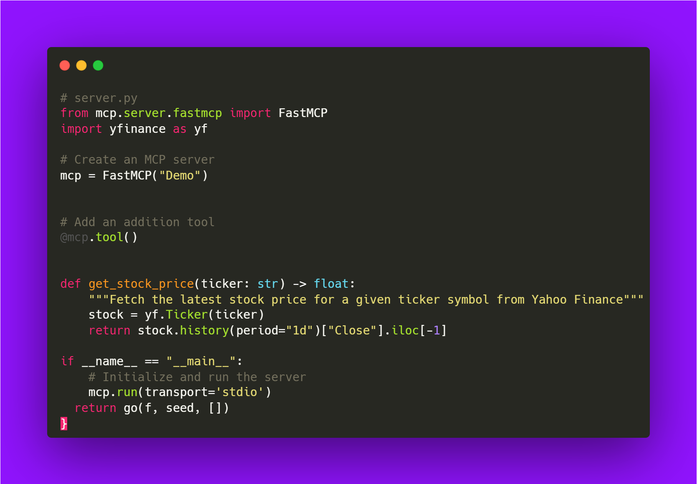

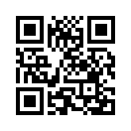
EXAMPLE: WEATHER FORECAST MCP SERVER
Claude Desktop as MCP Host
💻
Local Machine as MCP Server, using Python SDK
Tip: Find a catalog of MCP Servers here!
Source: https://mcpservers.org/

Slide 19
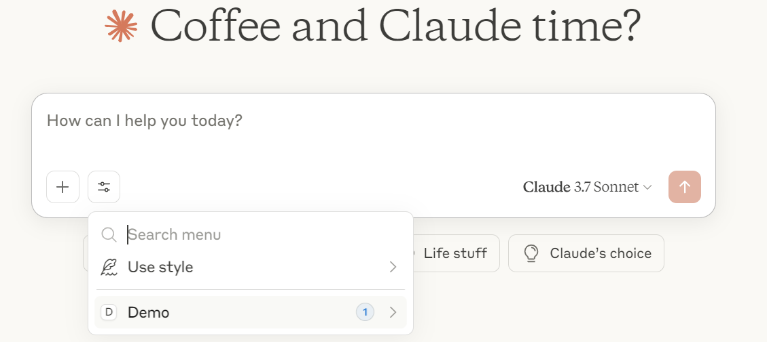
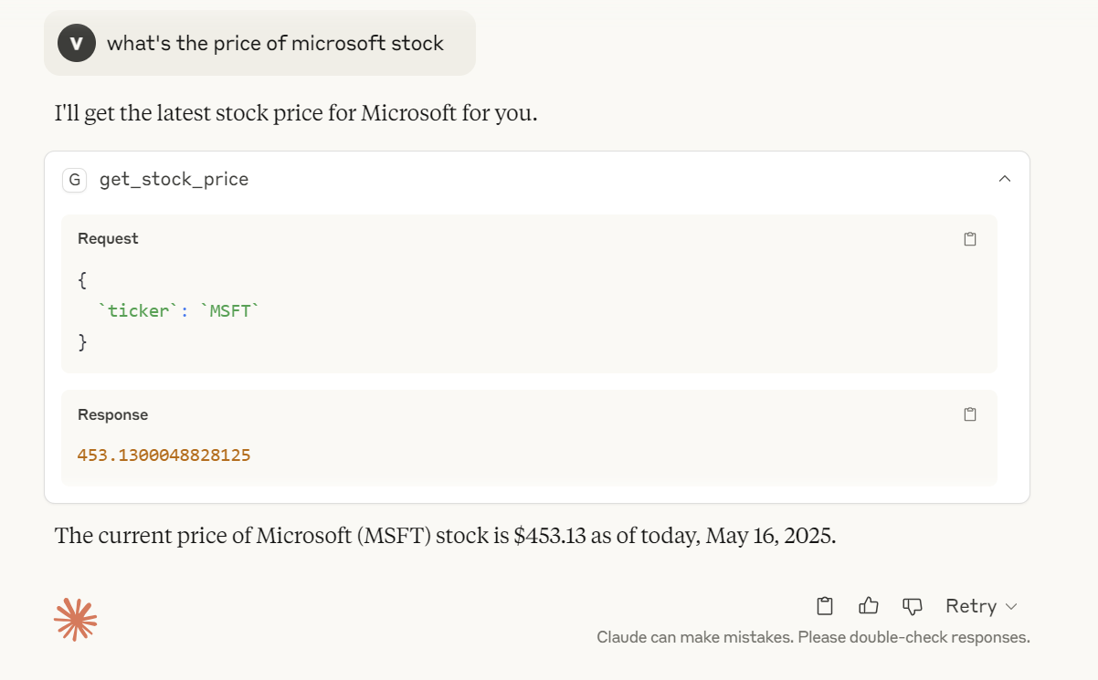
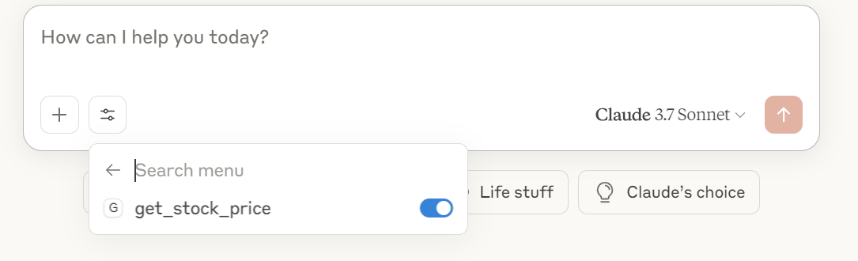
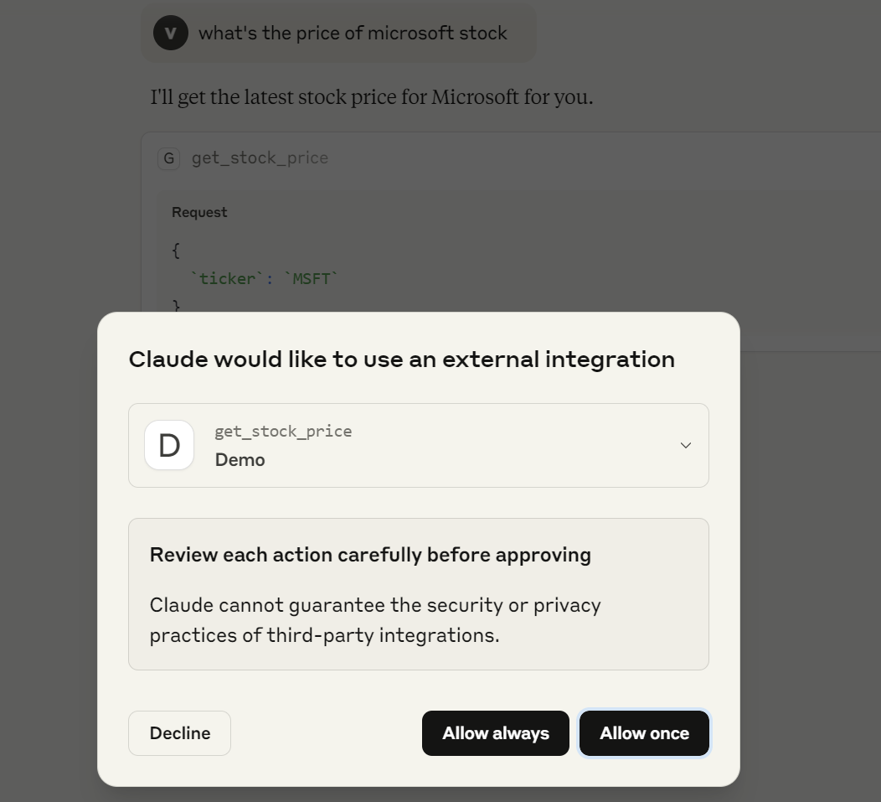

Slide 20
AI AGENTS OPEN PROTOCOLS
Model Context Protocol
Agent to Agent
NLWeb

Slide 21
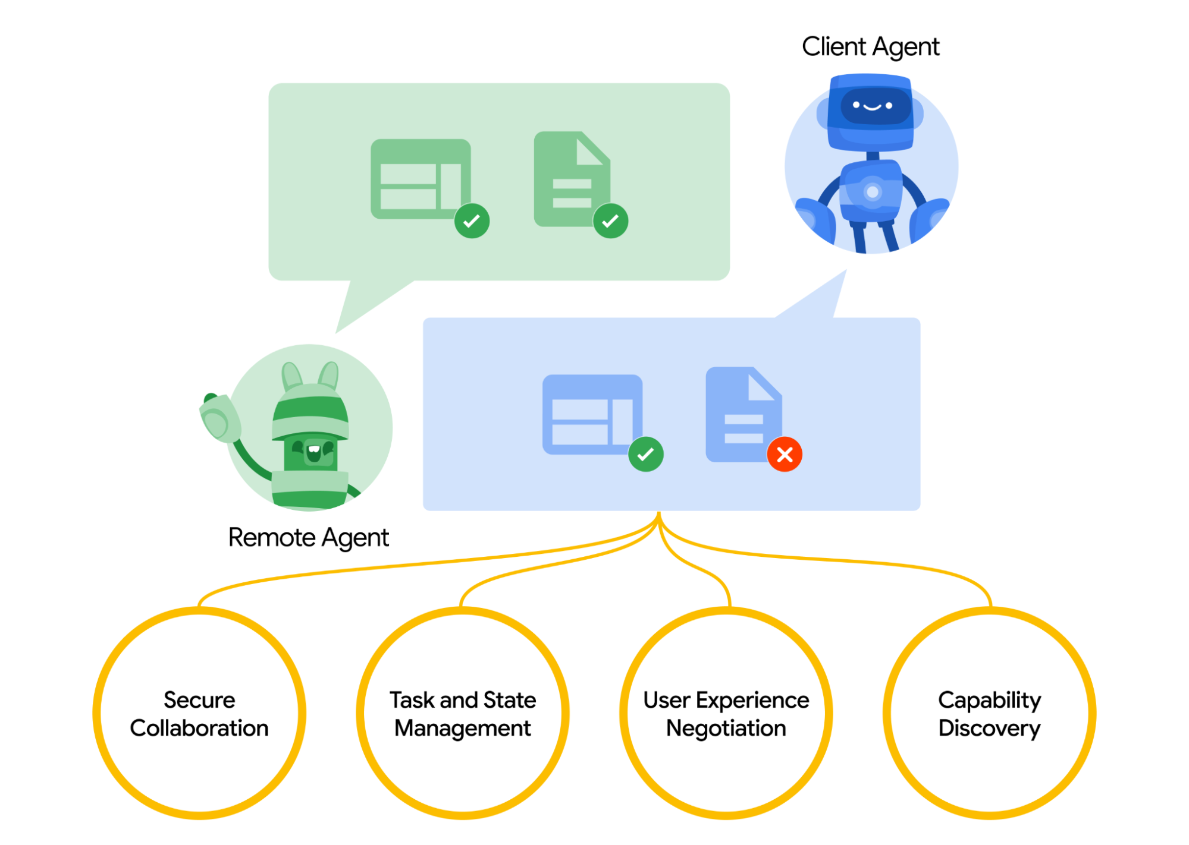
AGENT TO AGENT
“A2A Protocol is an open standard that enables AI agents to communicate and collaborate across different platforms and frameworks, regardless of their underlying technologies. It's designed to maximize the benefits of agentic AI by enabling true multi-agent scenarios.”
Image source: https://a2aprotocol.ai/
Source: https://a2aprotocol.ai/

Slide 22
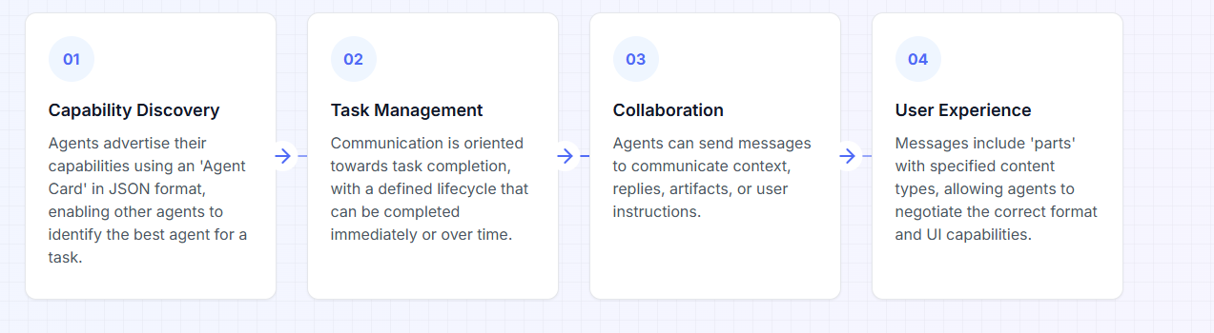
HOW DOES IT WORK
Source: https://a2aprotocol.ai/

Slide 23
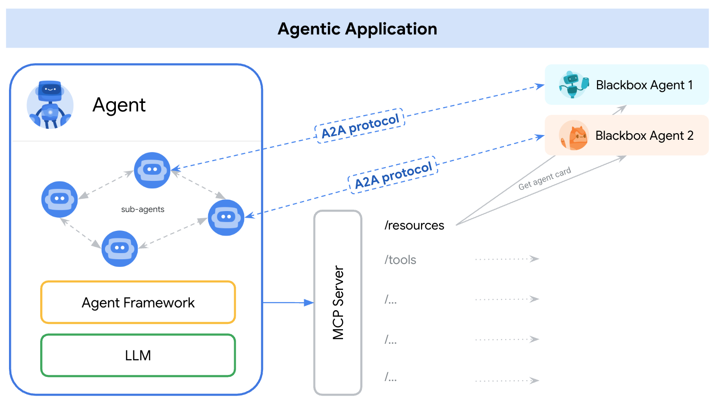
A2A VS MCP?
MCP
Protocol to connect LLMs with Data, Resources and Tools.
Protocol to connect and enable collaboration among multiple agents.
A2A
Source: https://a2aprotocol.ai/

Slide 24
AI AGENTS OPEN PROTOCOLS
Model Context Protocol
Agent to Agent
NLWeb

Slide 25
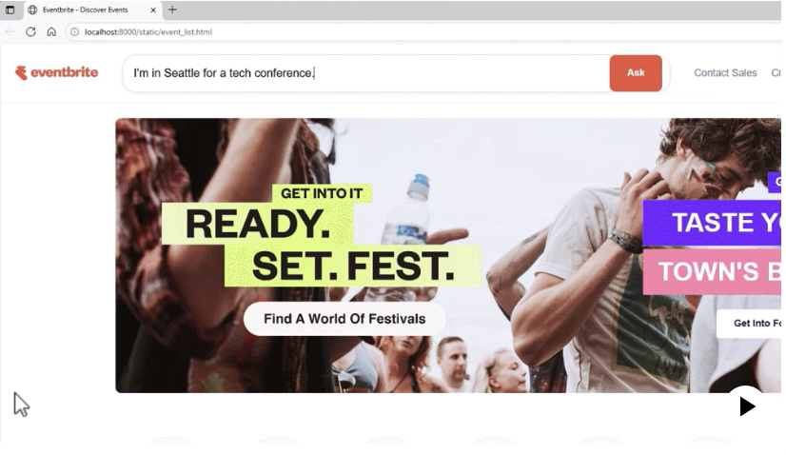
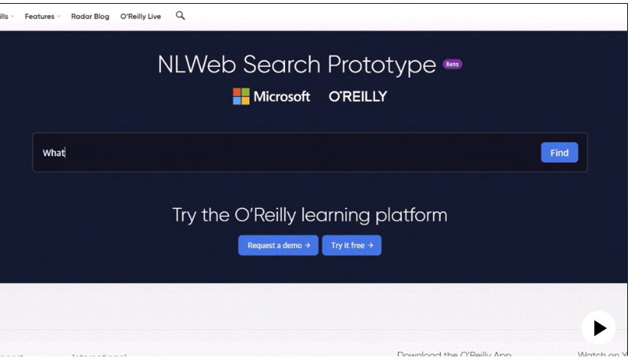
WHAT’S NLWEB?
“Building conversational interfaces for websites is hard. NLWeb seeks to make it easy for websites to do this. And since NLWeb natively speaks MCP, the same natural language APIs can be used both by humans and agents.”
Source: https://news.microsoft.com/source/features/company-news/introducing-nlweb-bringing-conversational-interfaces-directly-to-the-web/?msockid=16ccd88e67d963500e5fcd7866d062ac
Source: https://github.com/microsoft/nlweb

Slide 26


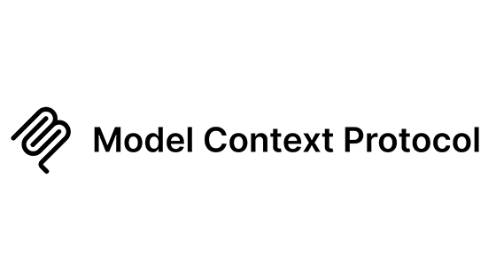
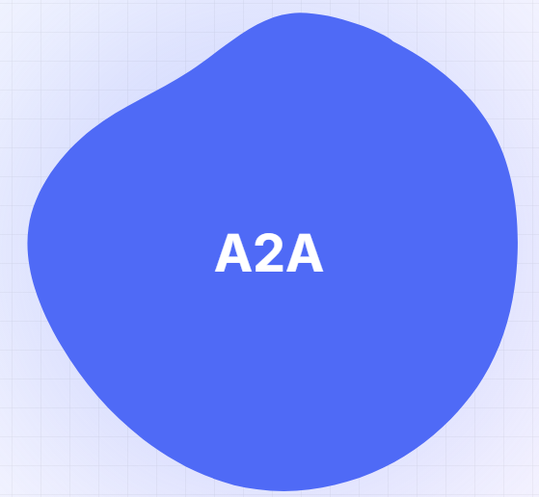
BUILDING THE OPEN AGENTIC WEB
Agent
Agent
Agent
Agents
🛠
🛠
🛠
📝
📝
📝
…..
Runtime
🛠
🧠
It’s like HTTP!
🗂️
Reasoning
…..
Memory
Tools
Entitlement
Protocols
….
🌐
💻
Web
Apps
Other Agents
The World
🤖
Source: https://github.com/microsoft/nlweb

Slide 27
VALENTINA ALTO
JAN 25, 2025
THANK YOU!
Questions?
Let’s Keep in touch!

